Slide 1
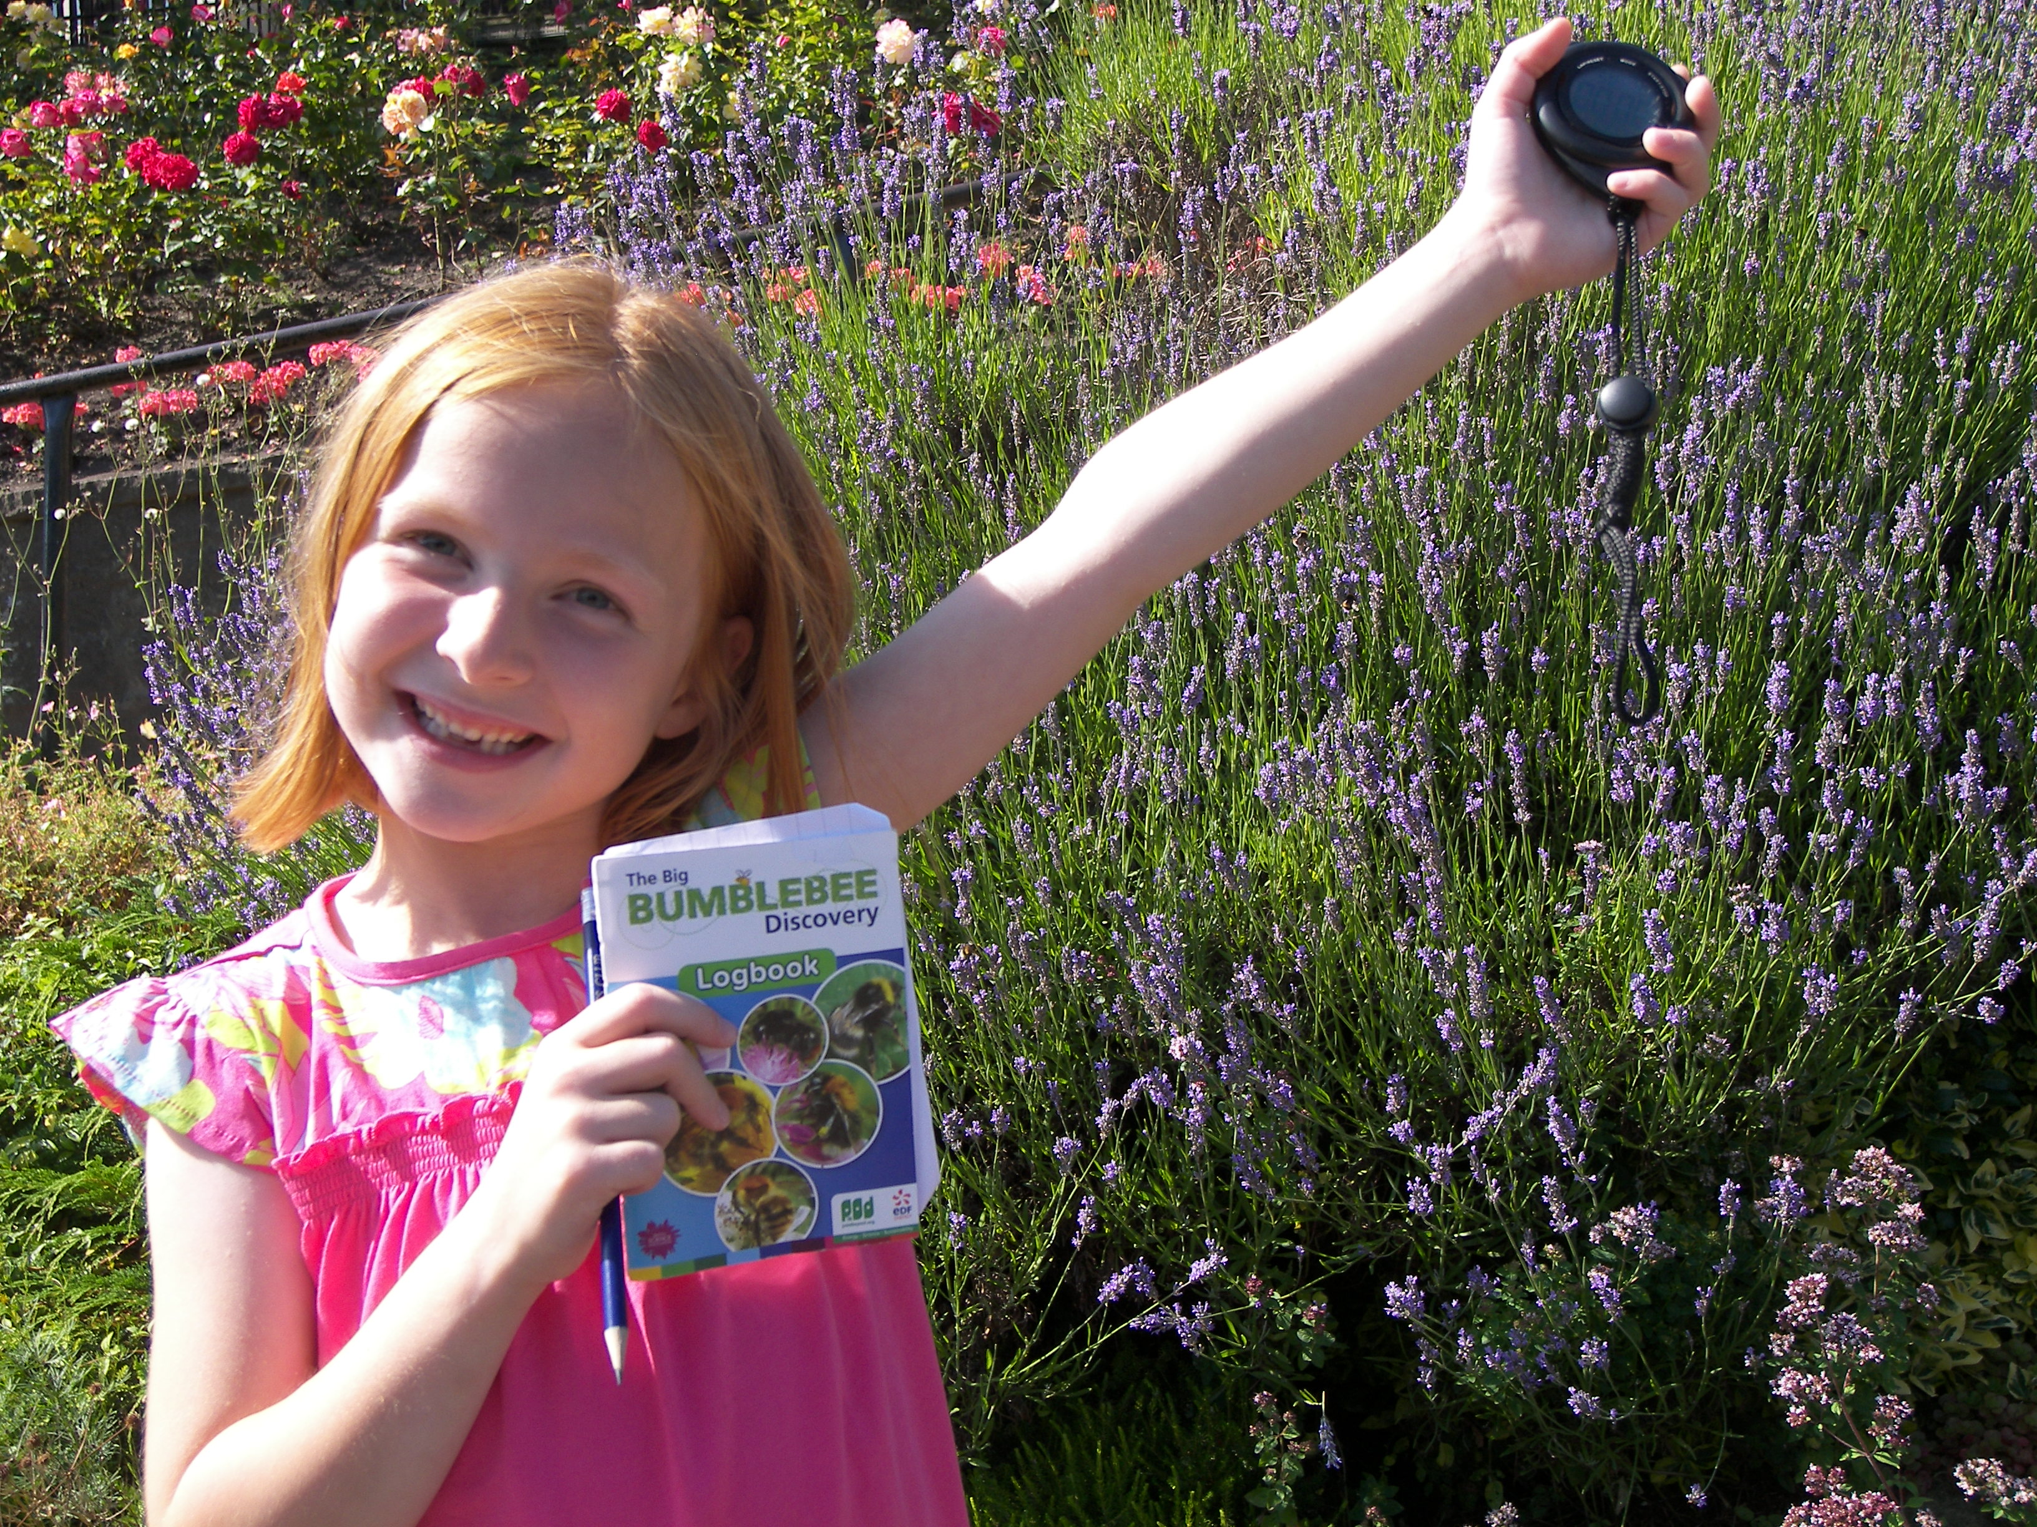
Susan’s Bumblebee Experiment Edinburgh
2014

Slide 2
We did 20 experiments Every time you answer questions about when, where and the weather
X
X
X
X

Slide 3
Every time look for 15 minutes at lavender plant and write down the number of bumblebees
2
0
6
0
12
0

Slide 4
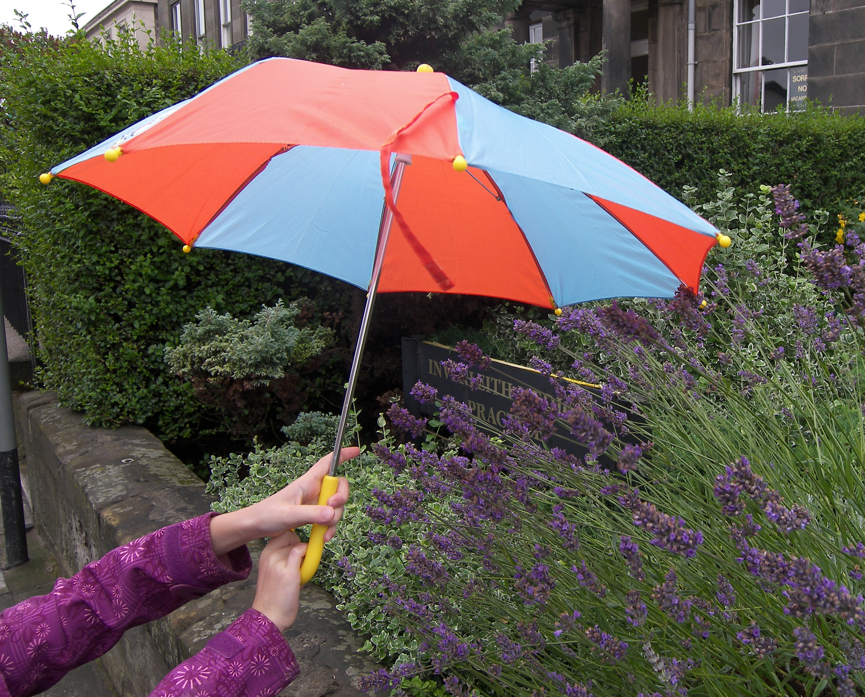
Do bumblebees like wind, rain or sun?
Slight breeze: 131 bumblebees
Windy: 33 bumblebees
Rain: no bumblebees
Sunny: lots of bumblebees!

Slide 5
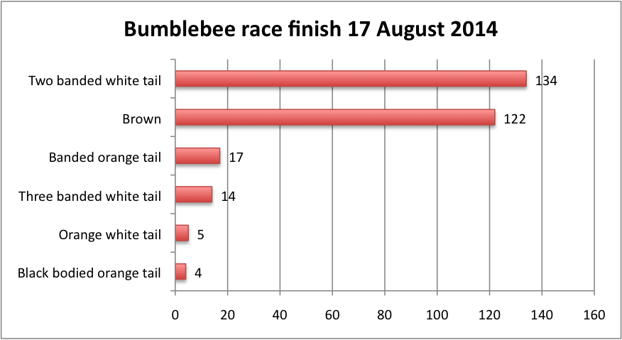
We counted 296 bumblebees! And the winner is…
Close second place for …

Slide 6
Mystery Bumblebee?
We discovered a one banded white tail in Princes Street Gardens!

Slide 7
